Slide 1

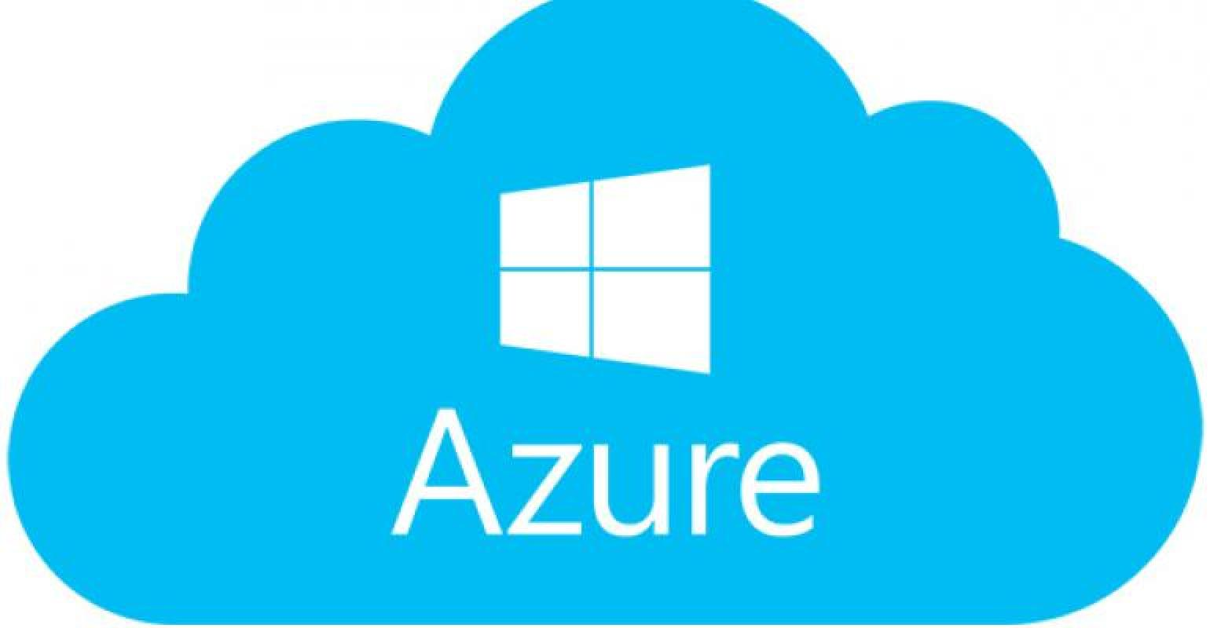
SSIS in the Cloud Azure Data Factory
Presenter: Tim Pauley
Class: BIDD 220 Data Migration Techniques
Date Spring 2020

Slide 2
What is Azure Data Factory
Microsoft Azure Data Factory is a cloud-based data integration service that automates the movement and transformation of data.
You can quickly: create, deploy, schedule, and monitor highly-available, fault tolerant data flow pipelines. Move and transform data of all shapes and sizes and deliver the results to a range of destination storage services. Monitor all of your data pipelines and service health at a glance with a rich visual experience.
Easily consume the data produced with BI, analytics tools, and other applications to drive key business insights and decisions.

Slide 3
Features – I will demo the yellow
Compose data storage, movement and processing services into data flow pipelines
Enhanced HDInsight integration including HCAT and on-demand cluster management
Schedule data pipelines with fine-tuned control
New data connectors for on-premises and cloud data sources
Integration with Azure Machine Learning and Azure Batch
Globally deployed data movement as a service
Create, edit and deploy data pipelines with a Visual Studio plug-in

Slide 4
When to use SSIS and when to use Azure Data Factory
SSIS On prem
Azure data factory
On Prem data
Cloud Data
On Prem Data

Slide 5
Data for Demo
Data Factory works well when you have two data sources in the cloud (or more) and would like to schedule refreshes on that dataset. I found the service valuable when working with complex models. For instance I will explain a Power BI example where the service was valuable.
The dataset I would like to explore is COVID-19 cases with home sales for King County Washington.
Questions:
1. Is and COVID cases?

Slide 6
Steps to the Covid-19 dataset
Step 1: Went to Bing.com
Step 2: Selected Covid-19 link
Step 3: Located about this dataset right hand corner
Step 4: Found Github account
Step 5: Read about dataset
What are the sources of the data?
We collect data from multiple trusted, reliable sources, including the World Health Organization (WHO), Centers for Disease Control and Prevention (CDC), national and state public health departments, BNO News, 24/7 Wall St., and Wikipedia.
Step 6: Forked Github and downloaded dataset
Step 7: Downloaded to folder, opened dataset in excel and added pivot table to explore data

Slide 7
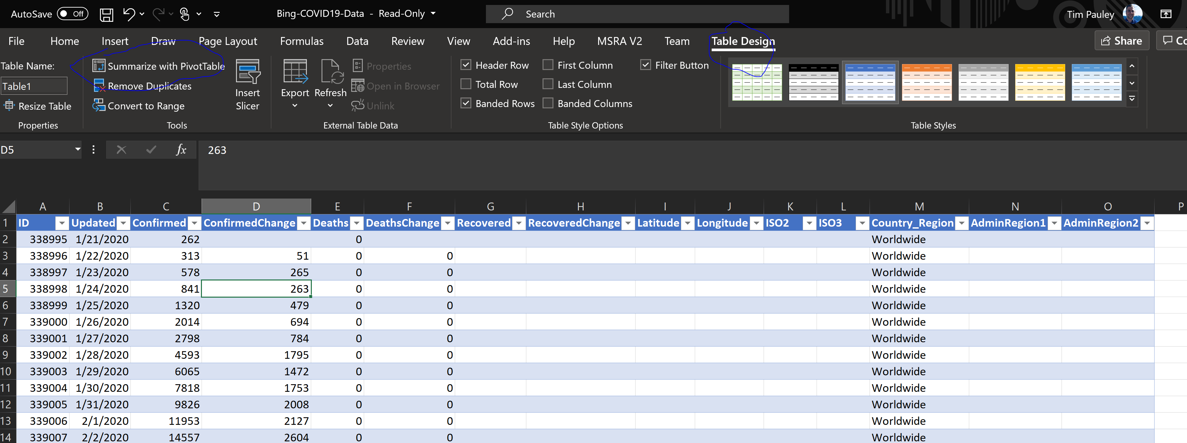
Pivot Table Exploring dataset
Step 1: Review the attributes and insert into a table. By holding down cntl+down arrow and cntl+right this can be accomplished easily
Step 2: Then by selecting ‘Table Design’ on the ribbon and select’ Summarize in Pivot Table’ we can look at the data in a more useful format

Slide 8
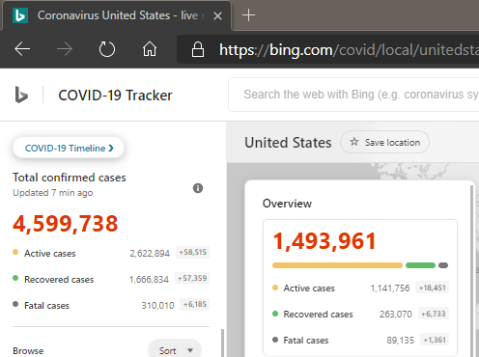
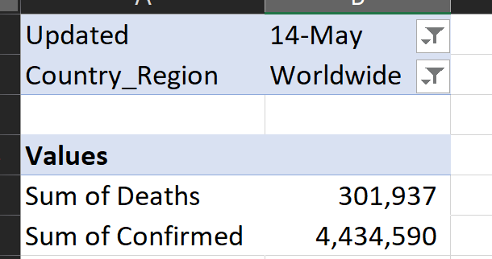
Pivot Table & getting the dataset to match
Step 1: What I noticed at first was the dataset was off once I put it into a pivot table. It took about 10 minutes for me to figure out what was going on.
Step 2: I needed to add in the actual date I was interested in and the the location. As you can see below, once I added this in everything aligned ☺
Step 3: I also confirmed the dataset it one day behind

Slide 9
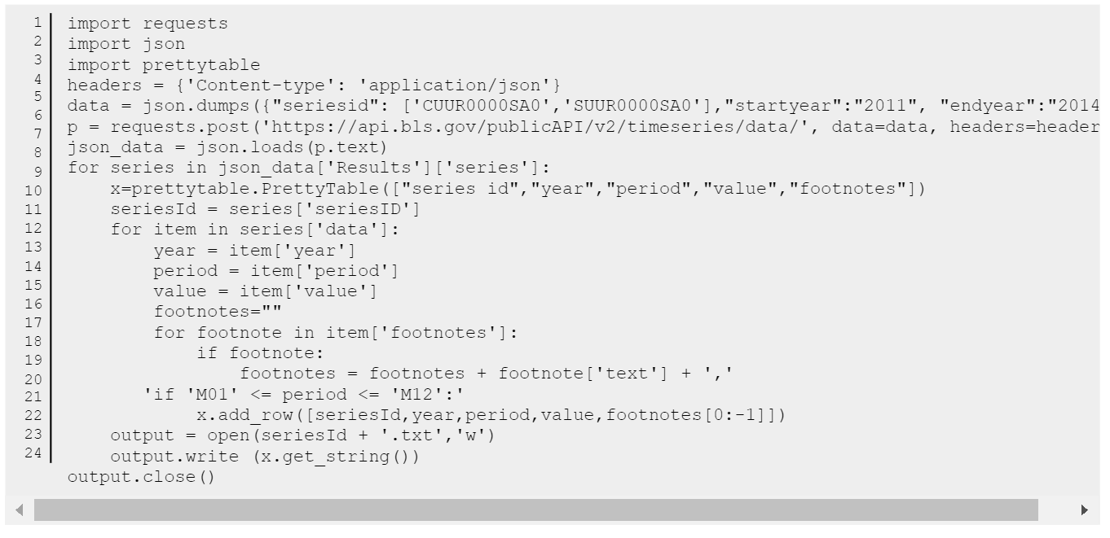
U.S. Bureau of Labor Statistics
Step 1: I want to retrieve a dataset by date, of unemployment stats.
Step 2: Went to this website: https://www.bls.gov/developers/
Step 3: Looked at sample code for Python and C#: https://www.bls.gov/developers/api_python.htm#python2
Step 4: reviewed code for Python

Slide 10
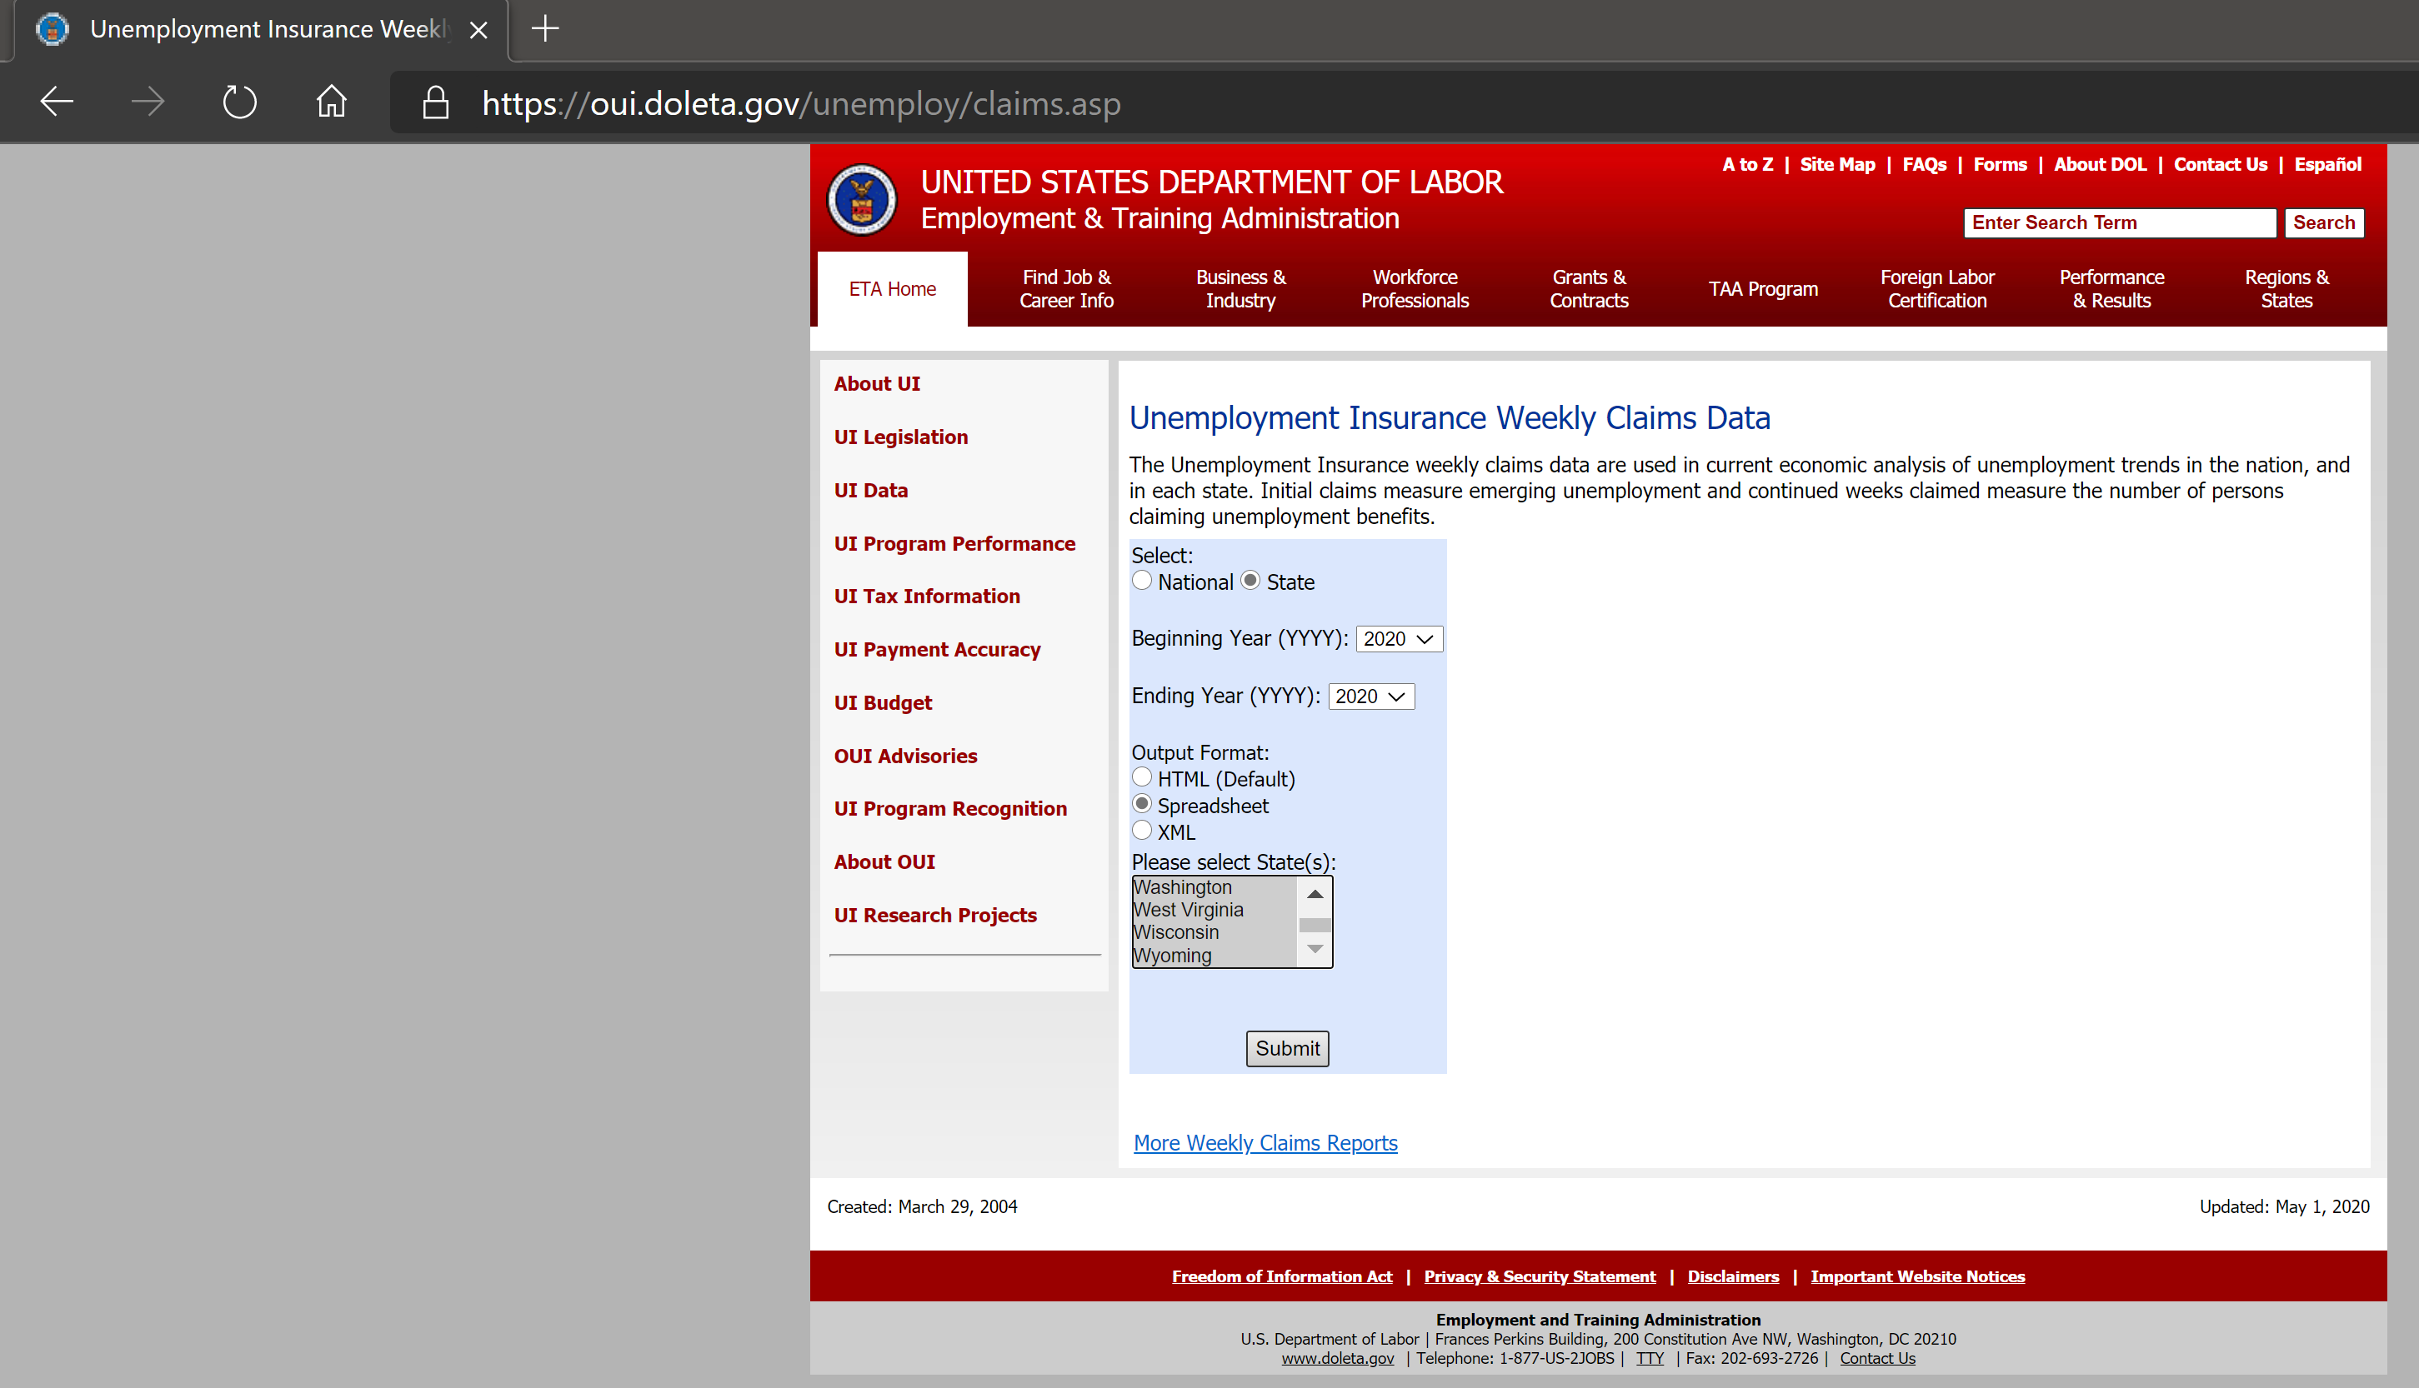
Department of Labor – easier dataset
This dataset was much easier to work with. Decided to go with it and pull 2020 data by state

Slide 11
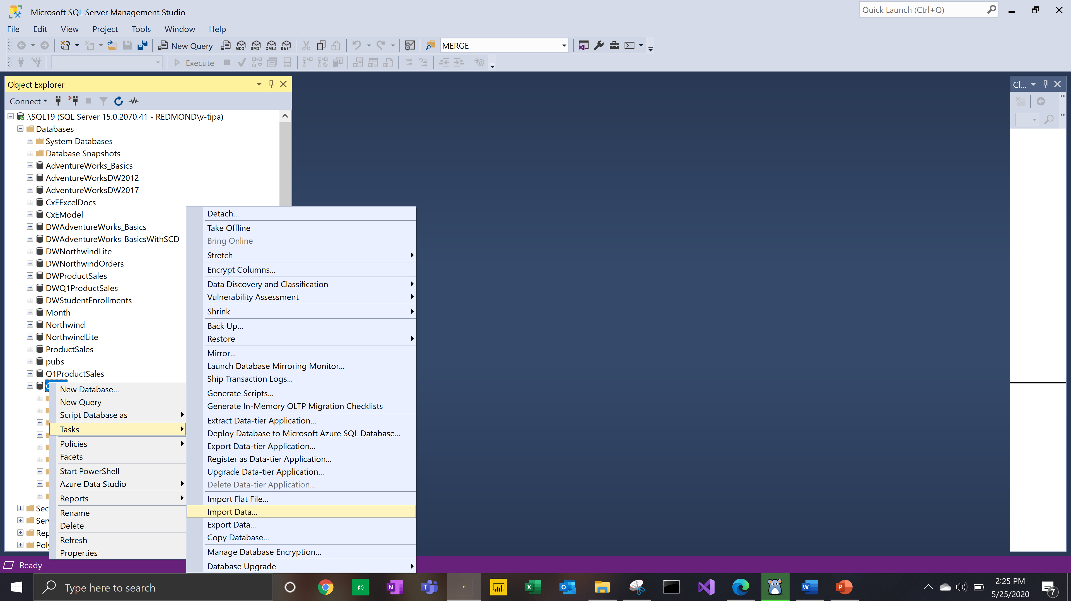
Load Data into SQL
I loaded two Tables into SQL using the excel import option:
BingCovid2020
Unemployment2020
It is a great tool for smaller datasets like this. Here is a screenshot of me loading it to my local instance. The database I created is Covid

Slide 12
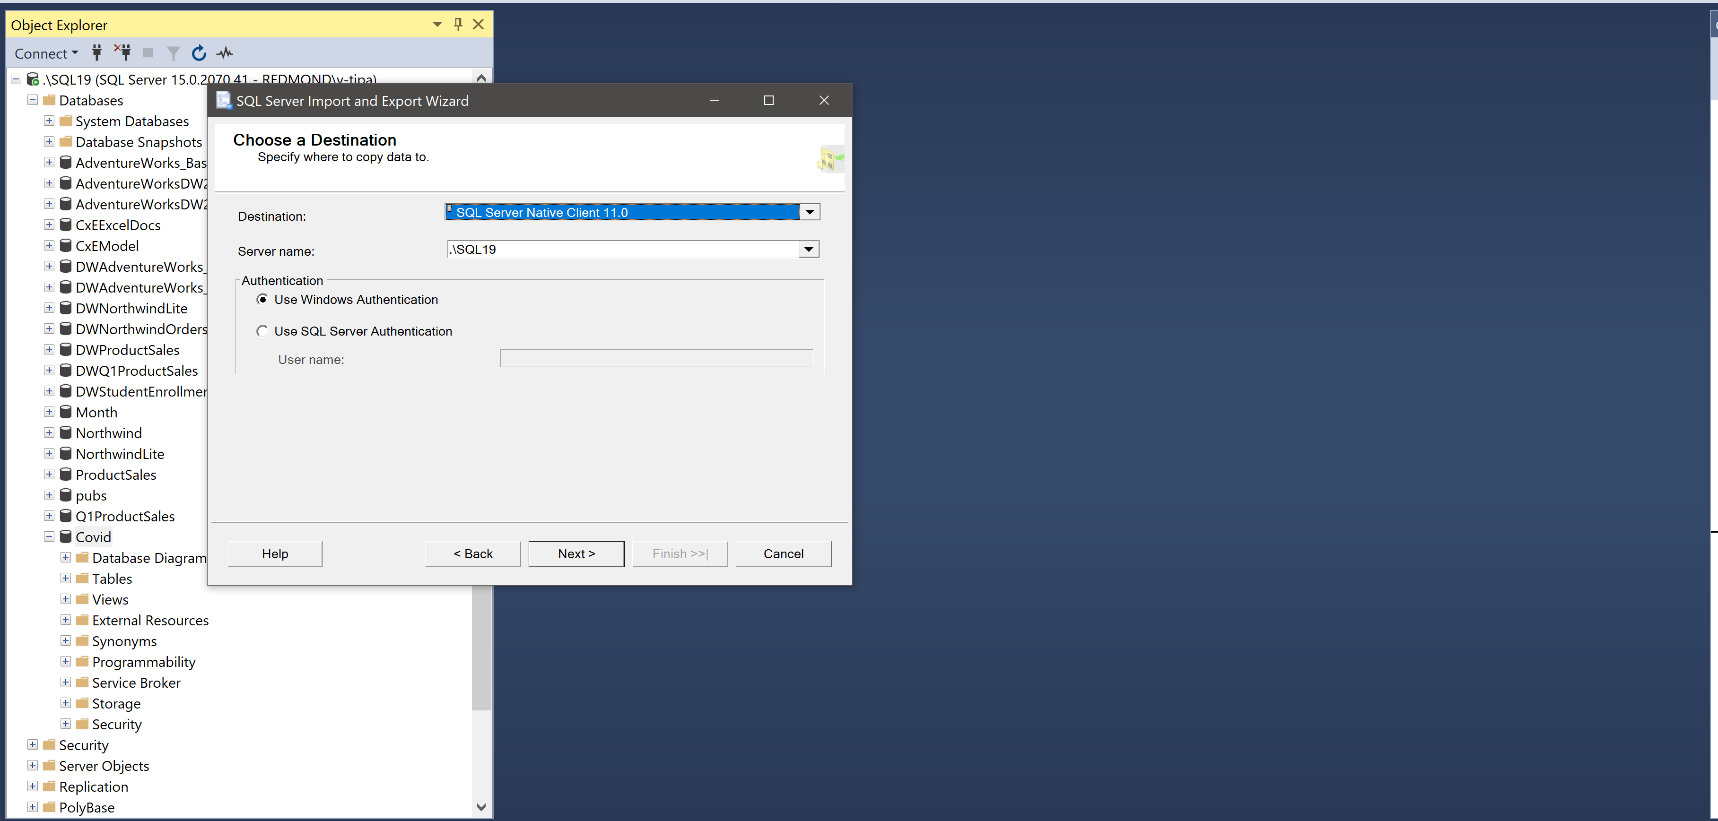
Load data into SQL - Tip
I have found you should always use this option

Slide 13
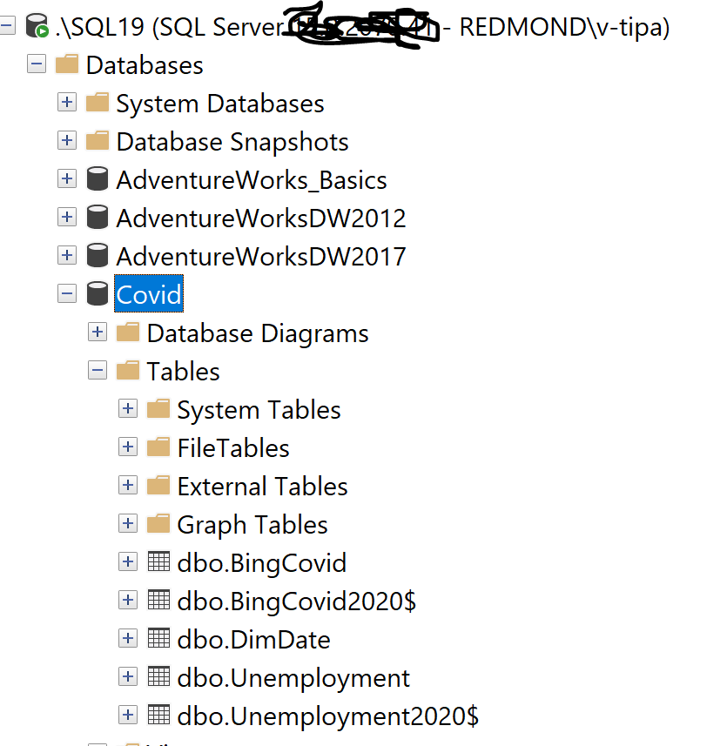
The Model
I have found you should always use this option

Slide 14
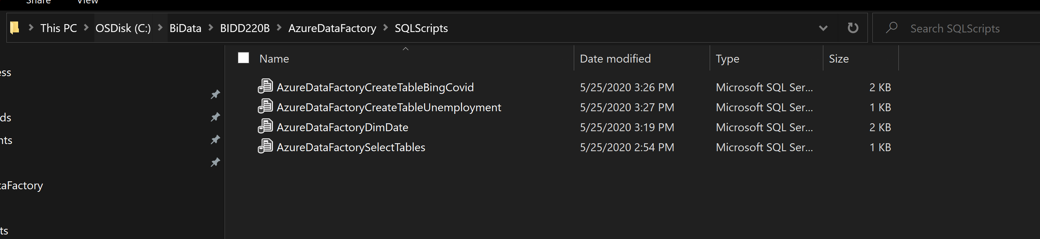
The Model
Demo scripts
Normally I do some basic data cleansing before I insert into a new database. For instance, I only want May 2020 data, & a DimDate Table.

Slide 15
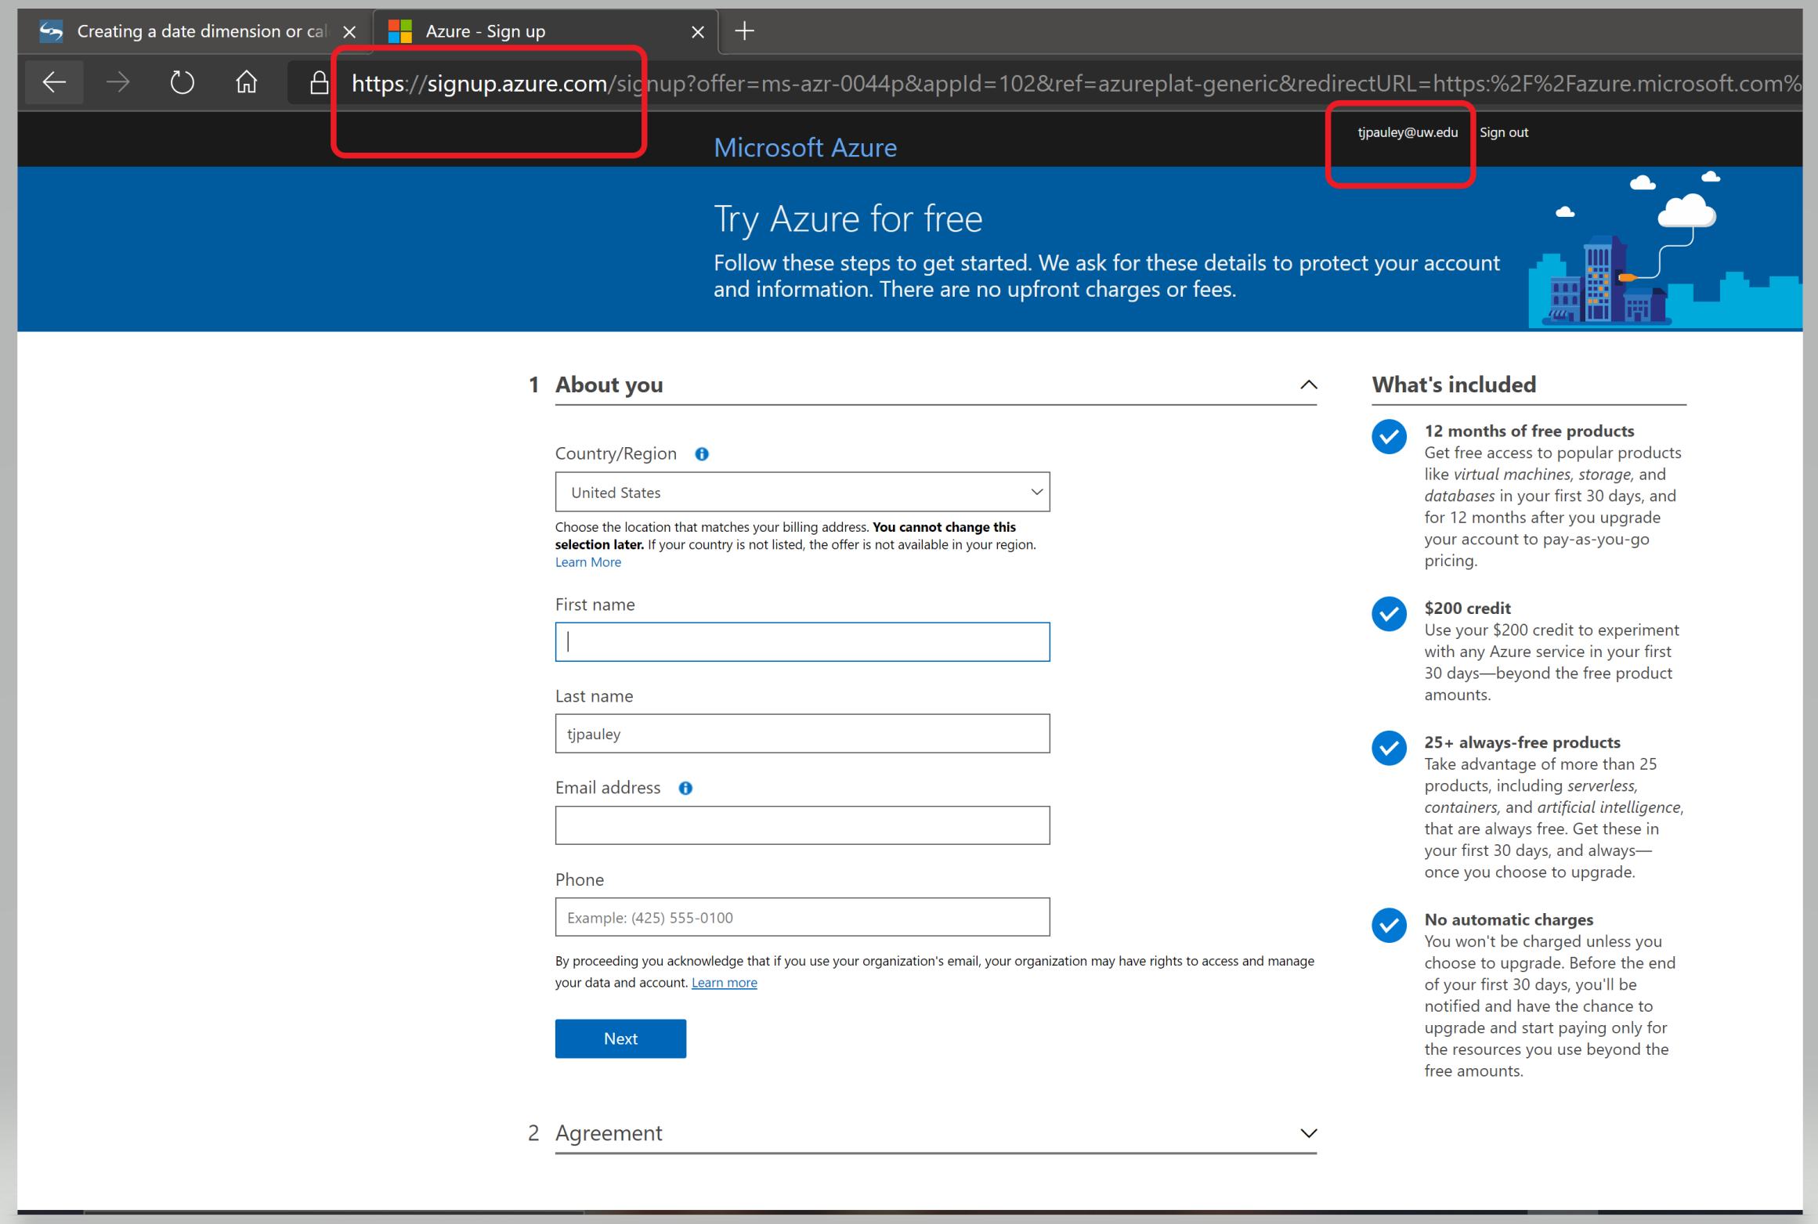
Azure Data Factory
Go to portal azure (I usually search for it)

Slide 16
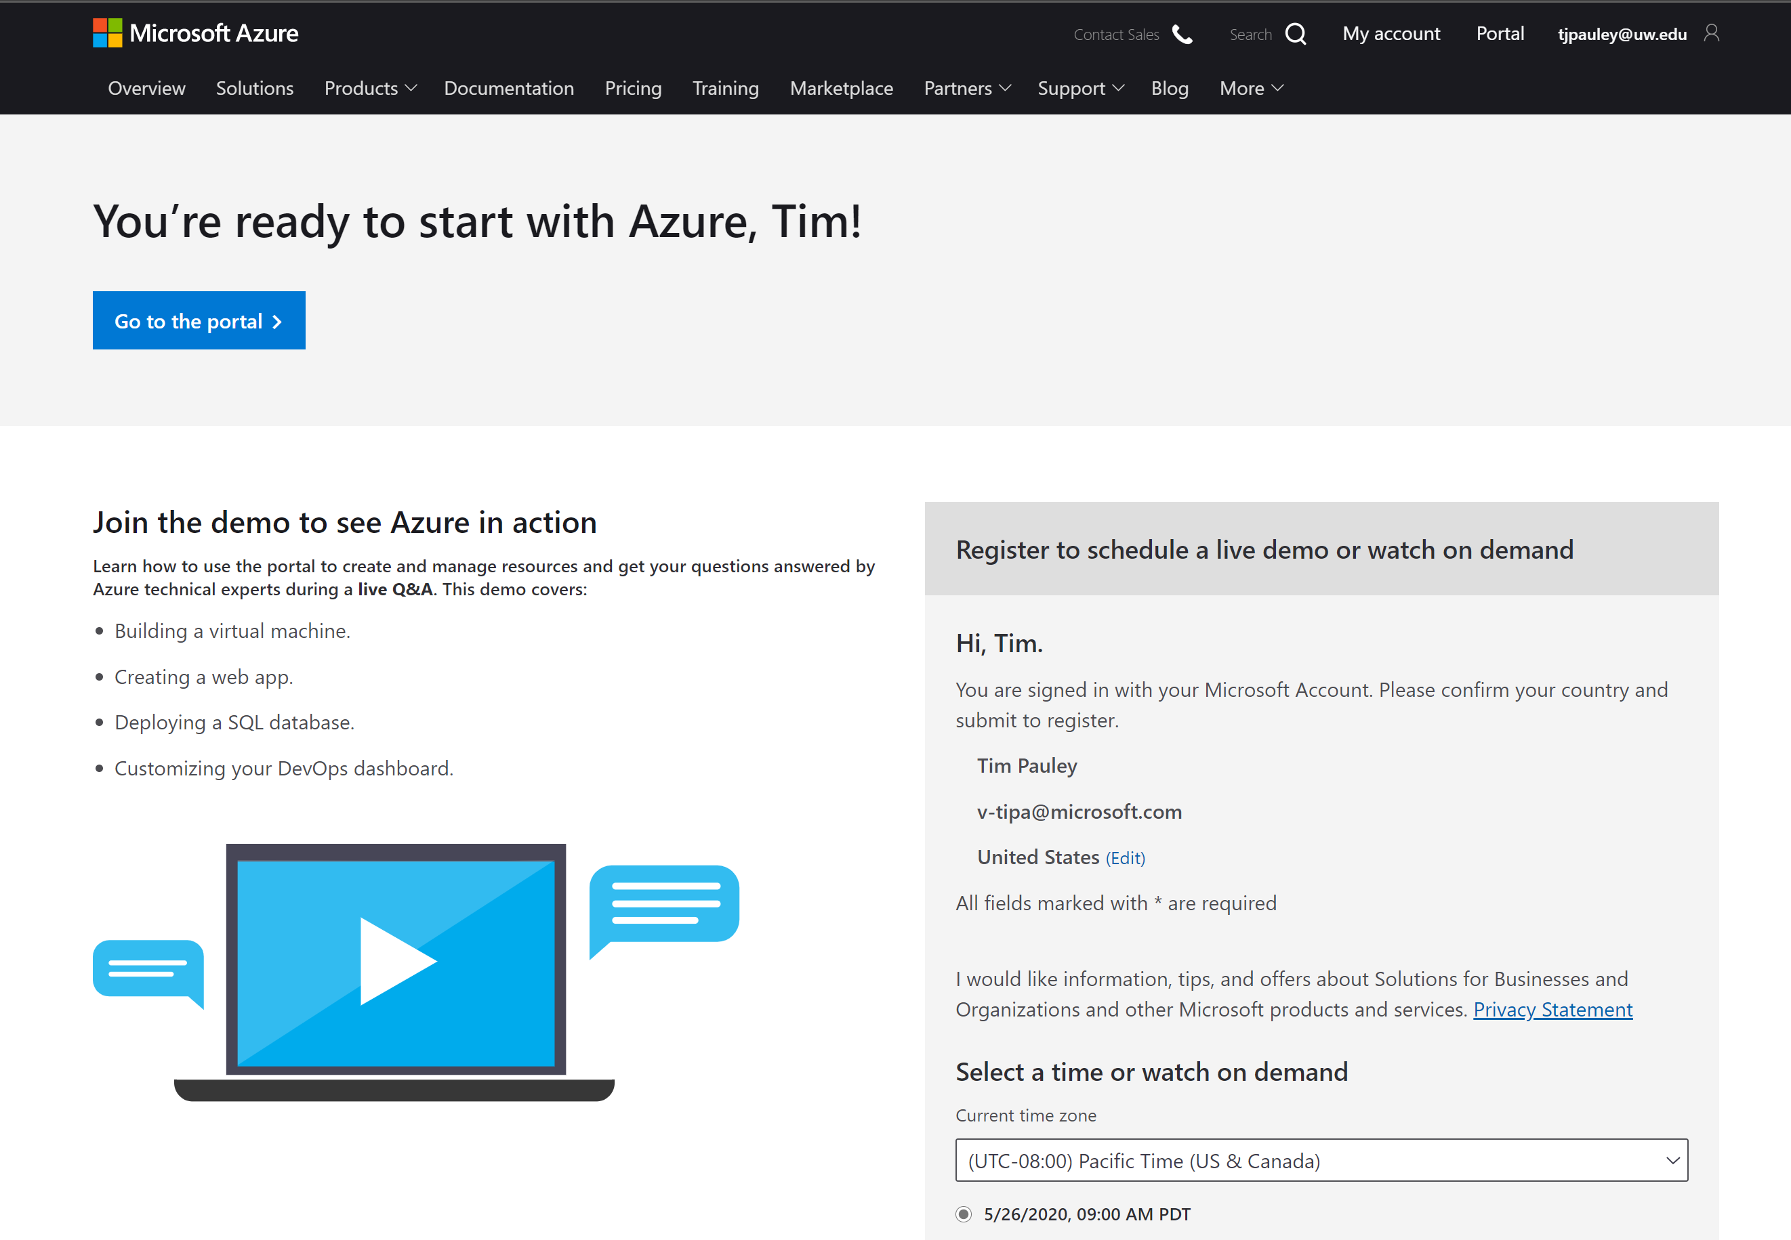
Azure Data Factory
Completed

Slide 17
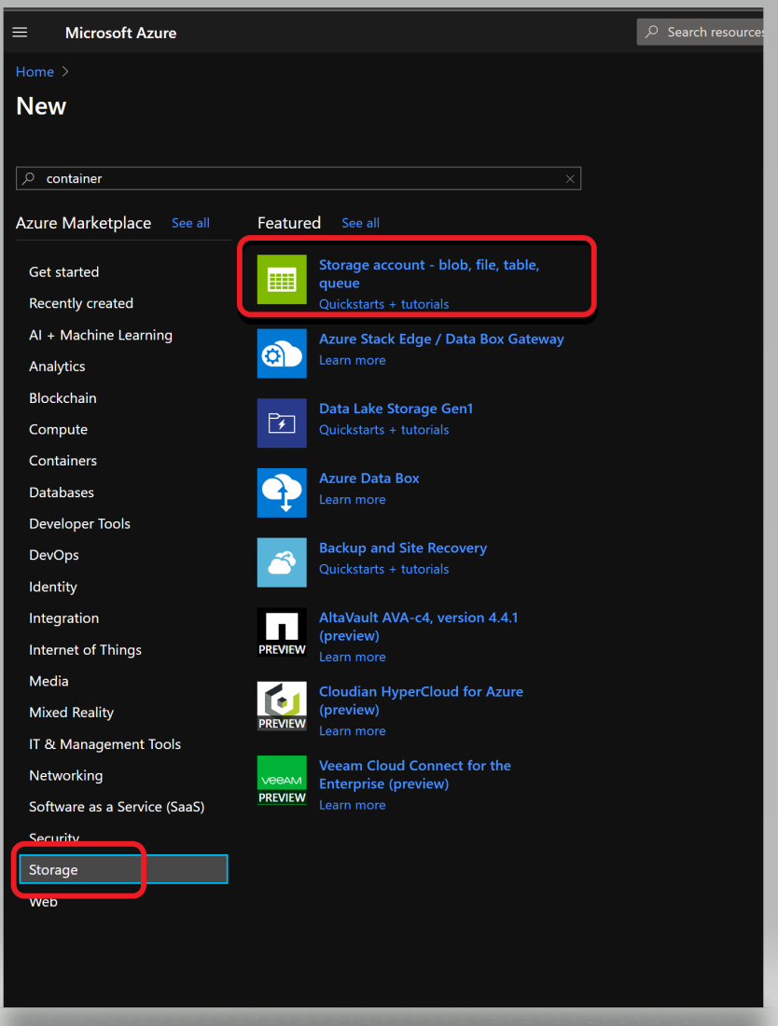
Azure Data Factory
From Bing search: Create container
Navigate to your new storage account in the Azure portal.
In the left menu for the storage account, scroll to the Blob service section, then select Containers.
Select the + Container button.
Type a name for your new container. ...
Set the level of public access to the container

Slide 18
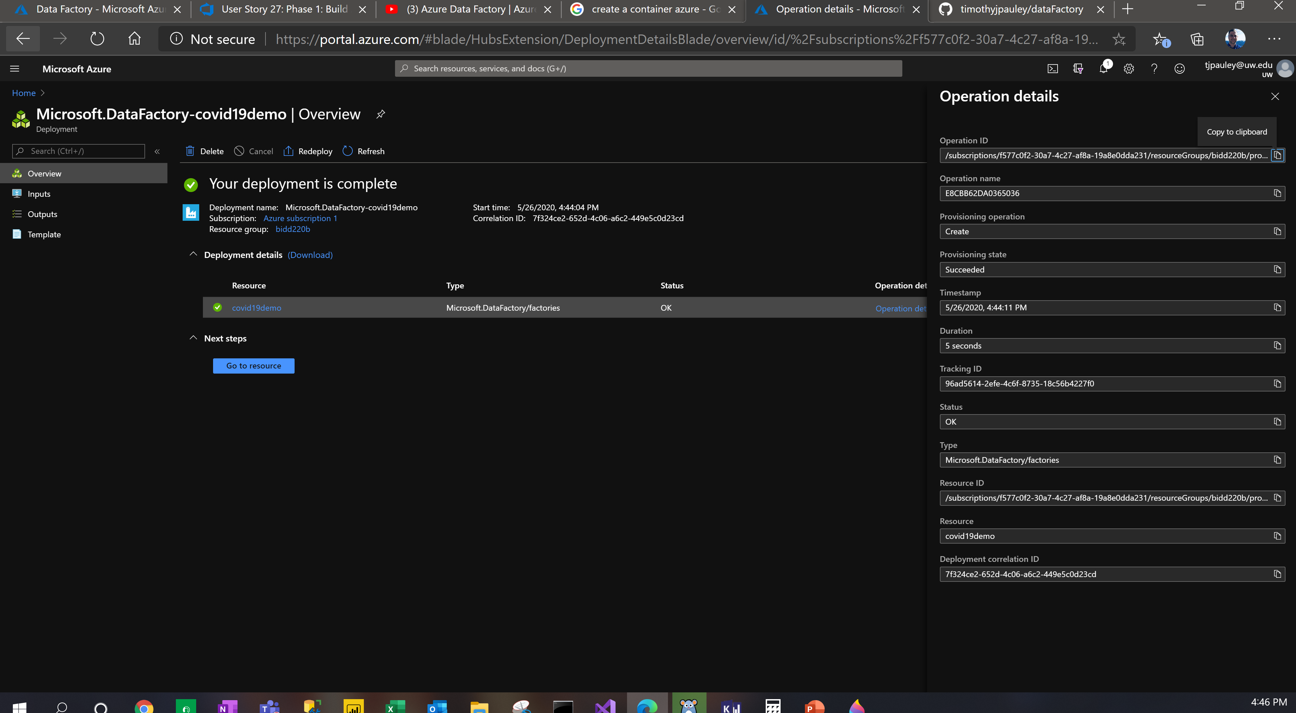
Azure Data Factory
Could not build a container so I built a Data Factory
Navigate to your new storage account in the Azure portal.
In the left menu for the storage account, scroll to the Blob service section, then select Containers.
Select the + Container button.
Type a name for your new container. ...
Set the level of public access to the container

Slide 19
Azure Data Factory
Could not build a container so I built a Data Factory
Navigate to your new storage account in the Azure portal.
In the left menu for the storage account, scroll to the Blob service section, then select Containers.
Select the + Container button.
Type a name for your new container. ...
Set the level of public access to the container

Slide 20
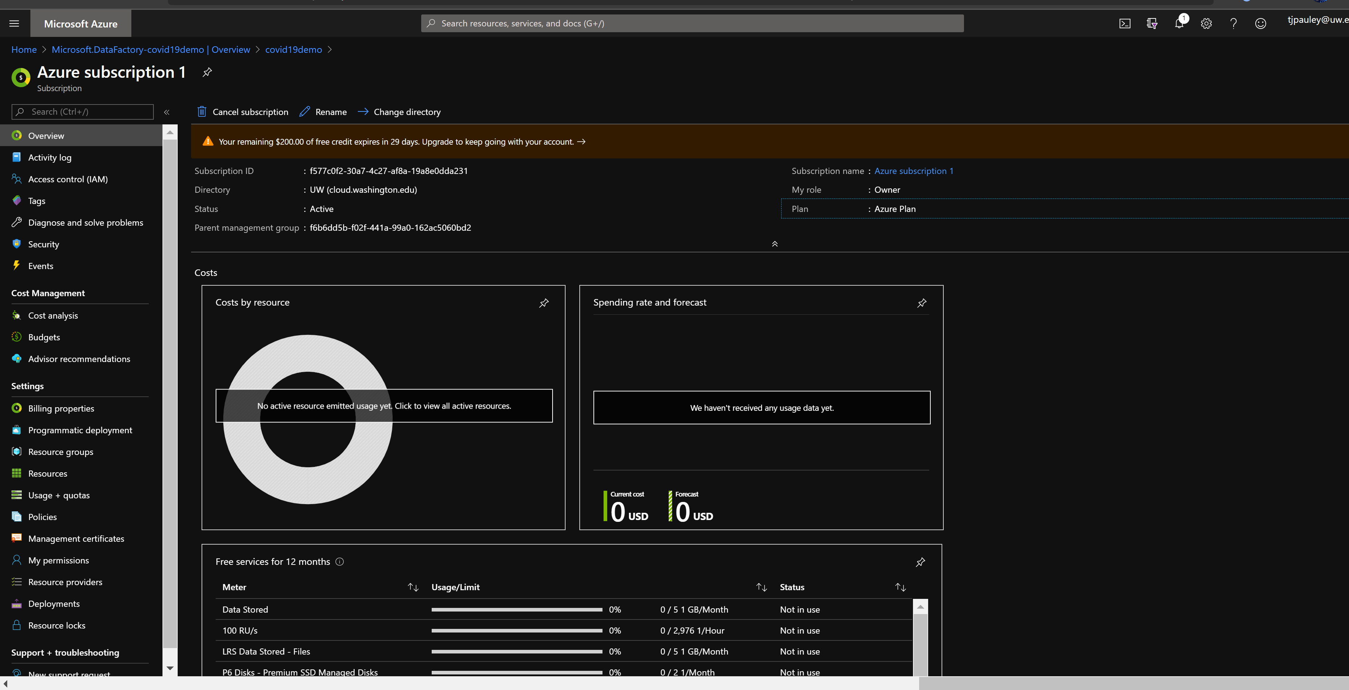
Azure Data Factory
This is what I got for FREE
Navigate to your new storage account in the Azure portal.
In the left menu for the storage account, scroll to the Blob service section, then select Containers.
Select the + Container button.
Type a name for your new container. ...
Set the level of public access to the container

Slide 21
Azure Data Factory- Credentials
This is where my subscription is located for the Azure Data Factory
https://portal.azure.com/#blade/HubsExtension/BrowseResourceGroups
This is the homepage:
https://portal.azure.com/#@cloud.washington.edu/resource/subscriptions/f577c0f2-30a7-4c27-af8a-19a8e0dda231/resourceGroups/bidd220b/overview
Then we select [Author] this is like a [New project] and then I set it up with my GitHub profile which is:
https://github.com/timothyjpauley/dataFactory

Slide 22
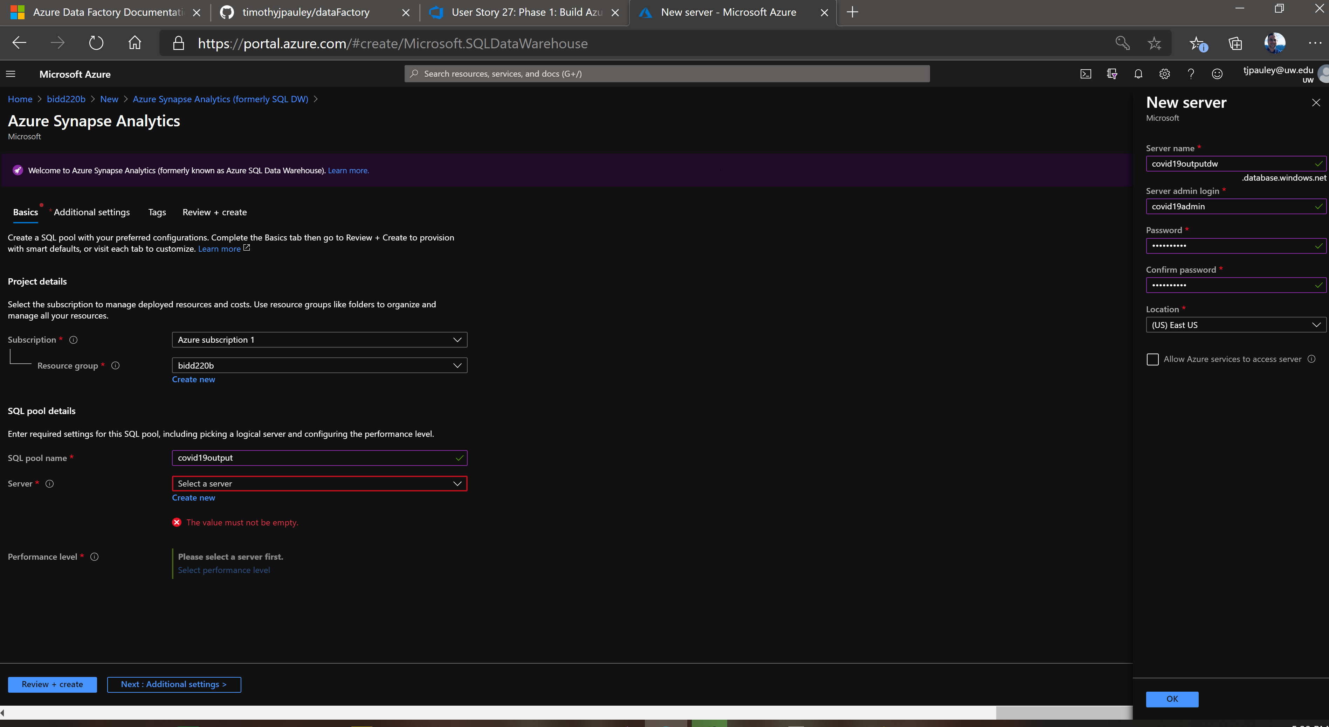
Azure Data Factory
This is where my subscription is located for the Azure Data Factory
https://portal.azure.com/#blade/HubsExtension/BrowseResourceGroups
This is the homepage:
https://portal.azure.com/#@cloud.washington.edu/resource/subscriptions/f577c0f2-30a7-4c27-af8a-19a8e0dda231/resourceGroups/bidd220b/overview
Then we select [Author] this is like a [New project] and then I set it up with my GitHub profile which is:
https://github.com/timothyjpauley/dataFactory

Slide 23
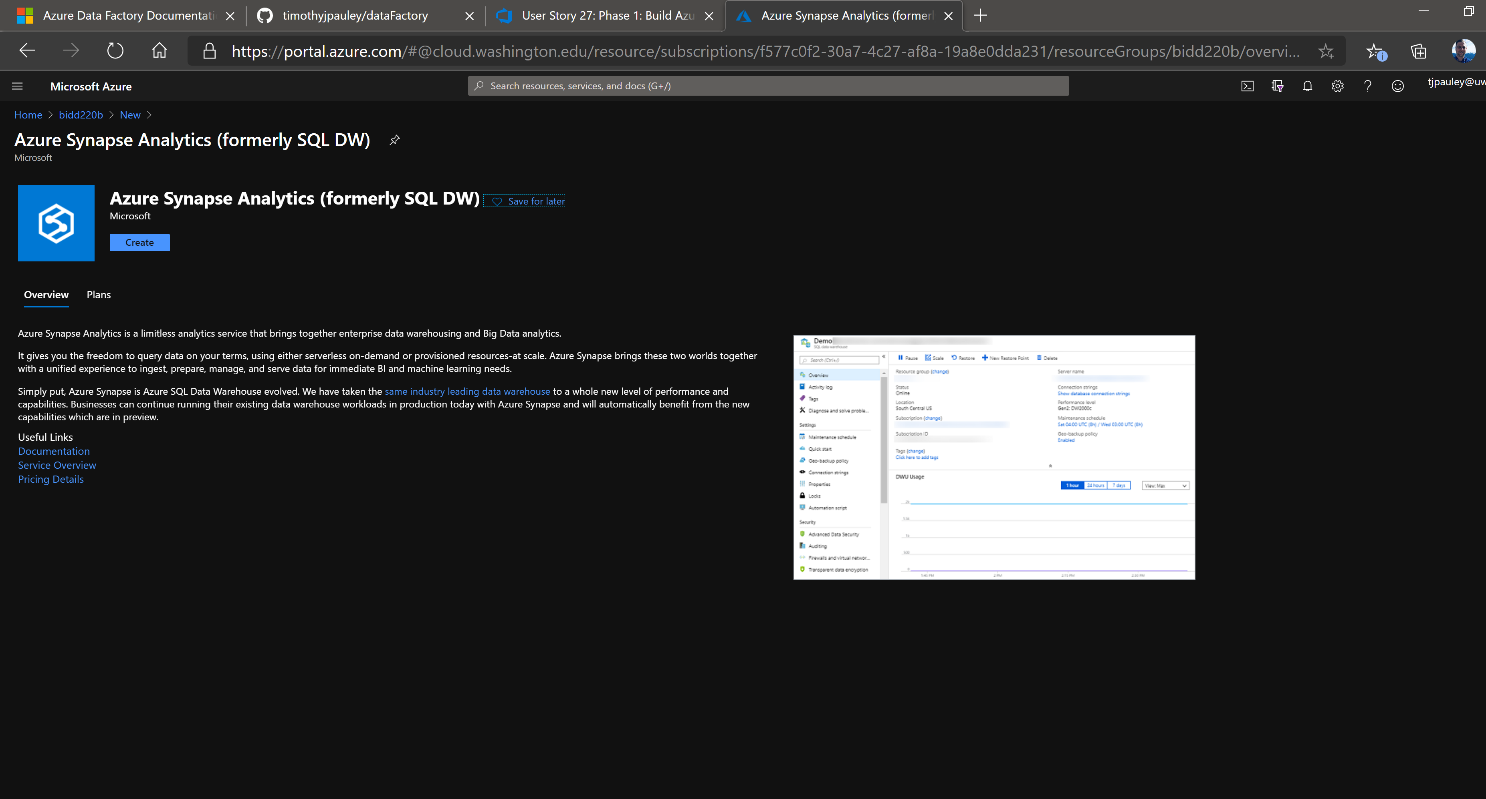
Azure Data Factory - Create DW

Slide 24
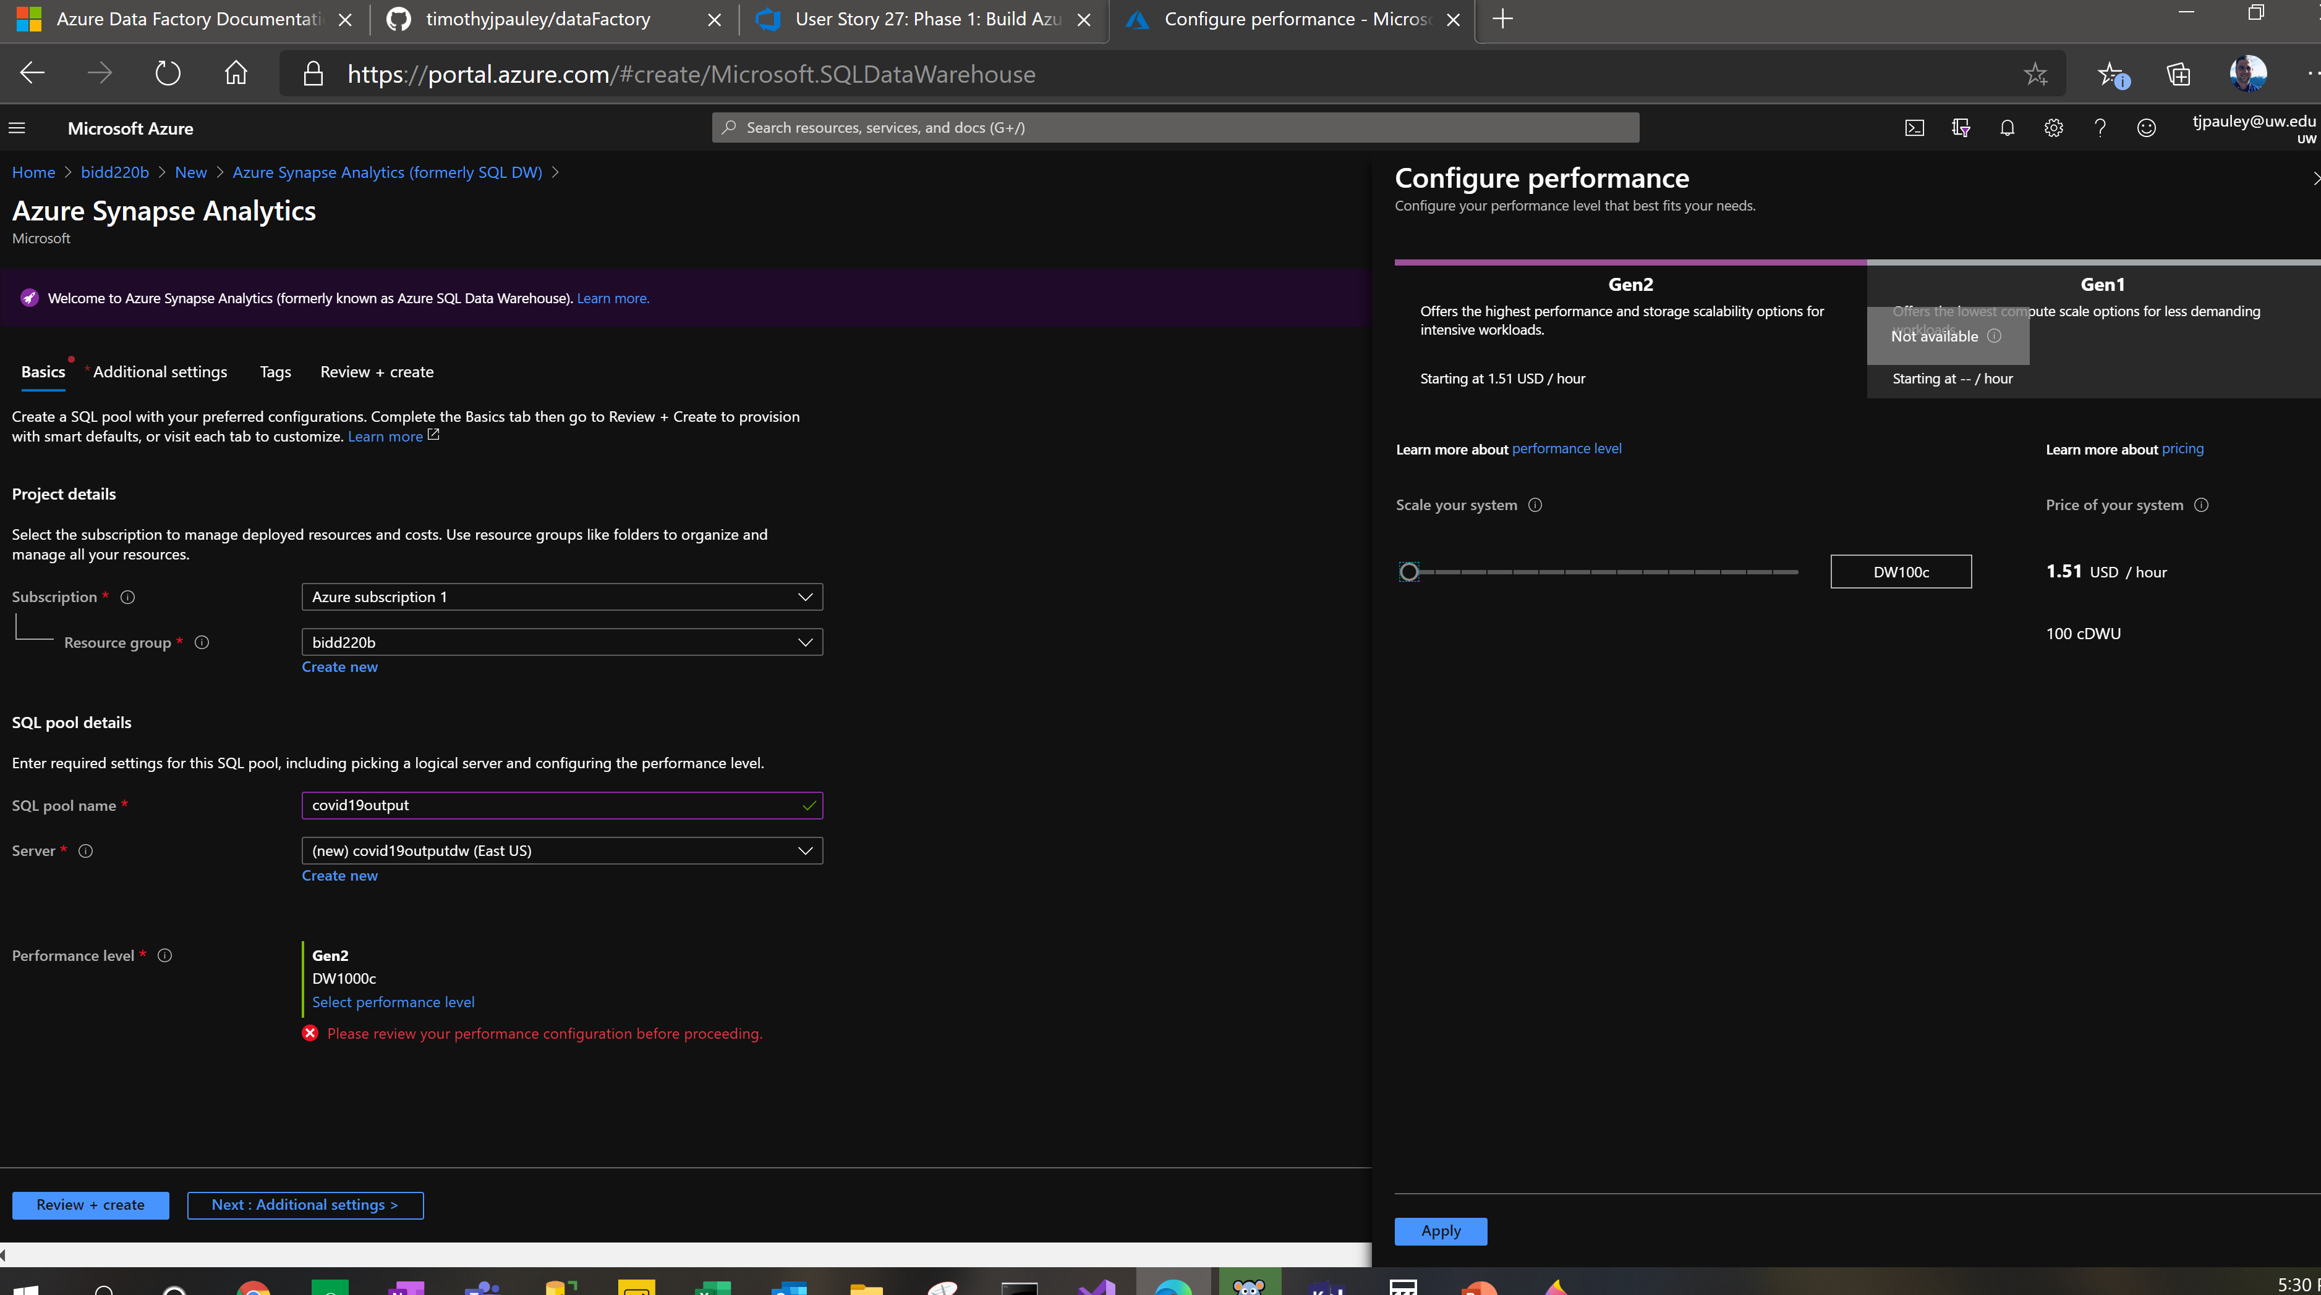
Azure Data Warehouse - Adjust price

Slide 25
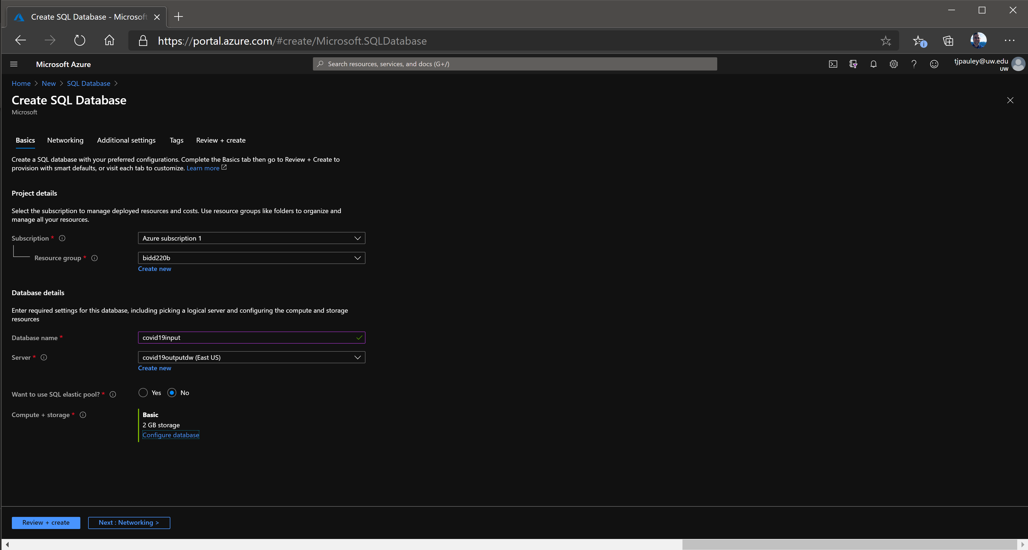
Azure SQL Server Database

Slide 26
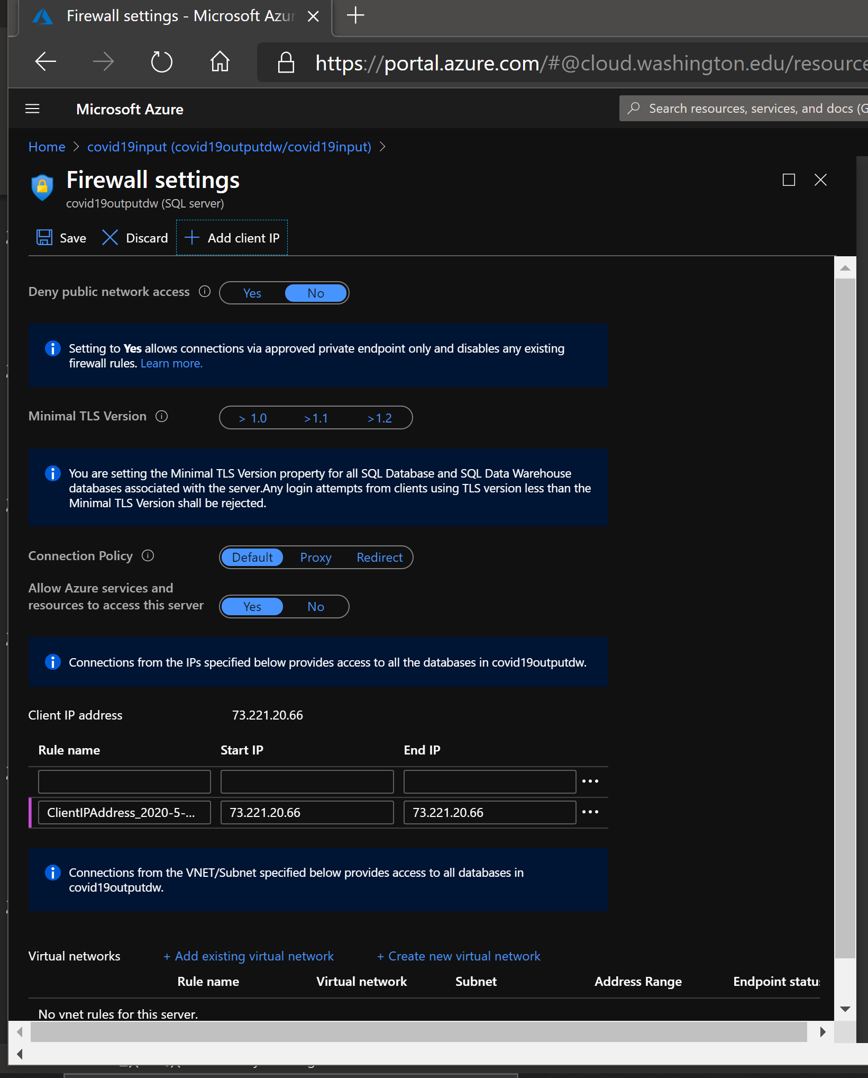
Azure SQL Server Database – Add Client IP Address

Slide 27
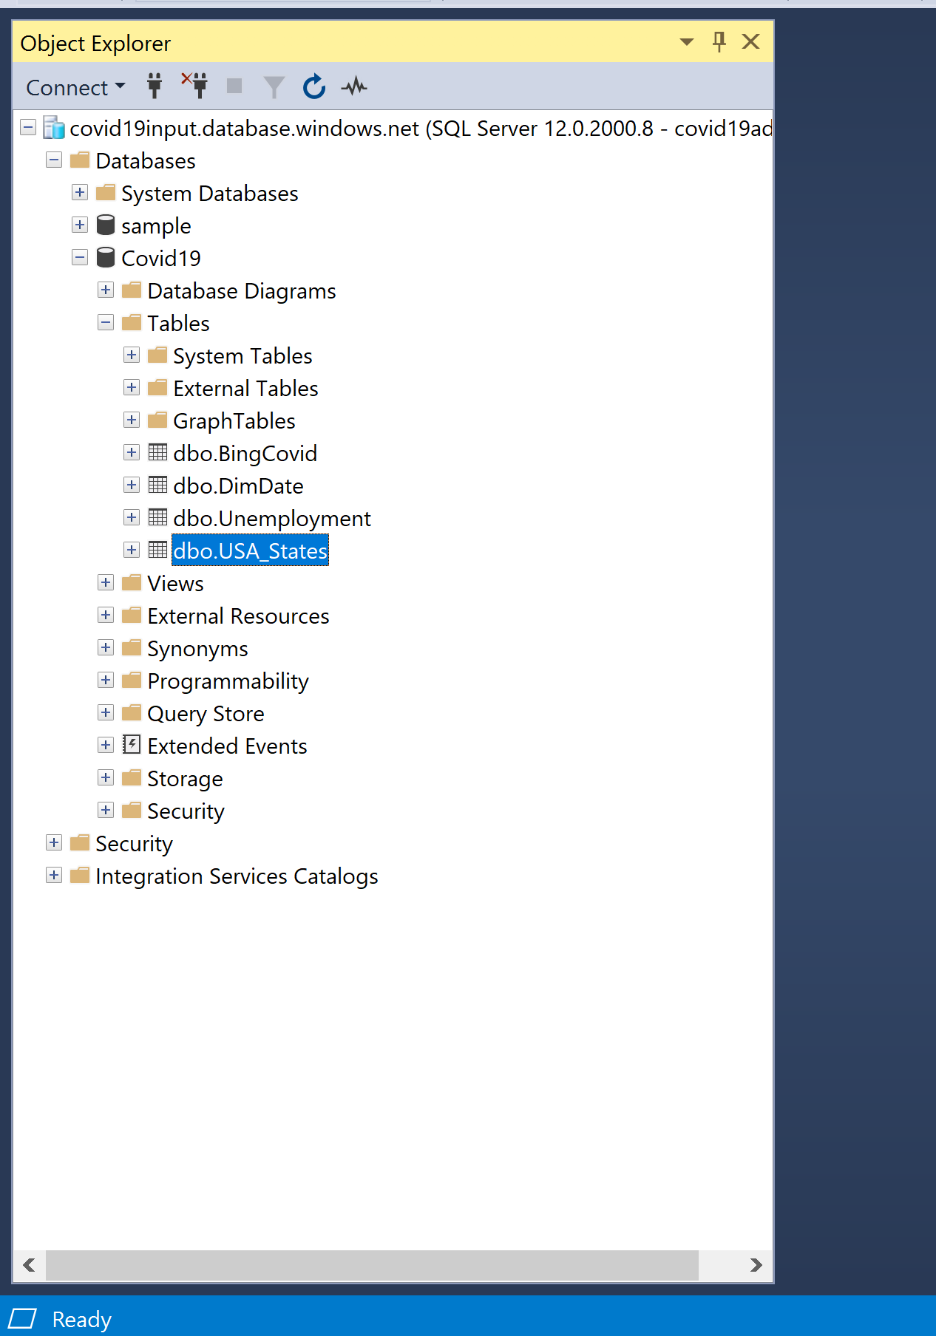
Azure SQL Server Database – export/import tier application

Slide 28
Azure SQL Server Database – export/import tier application

Slide 29
Azure SQL Server Database – export/import tier application

Slide 30
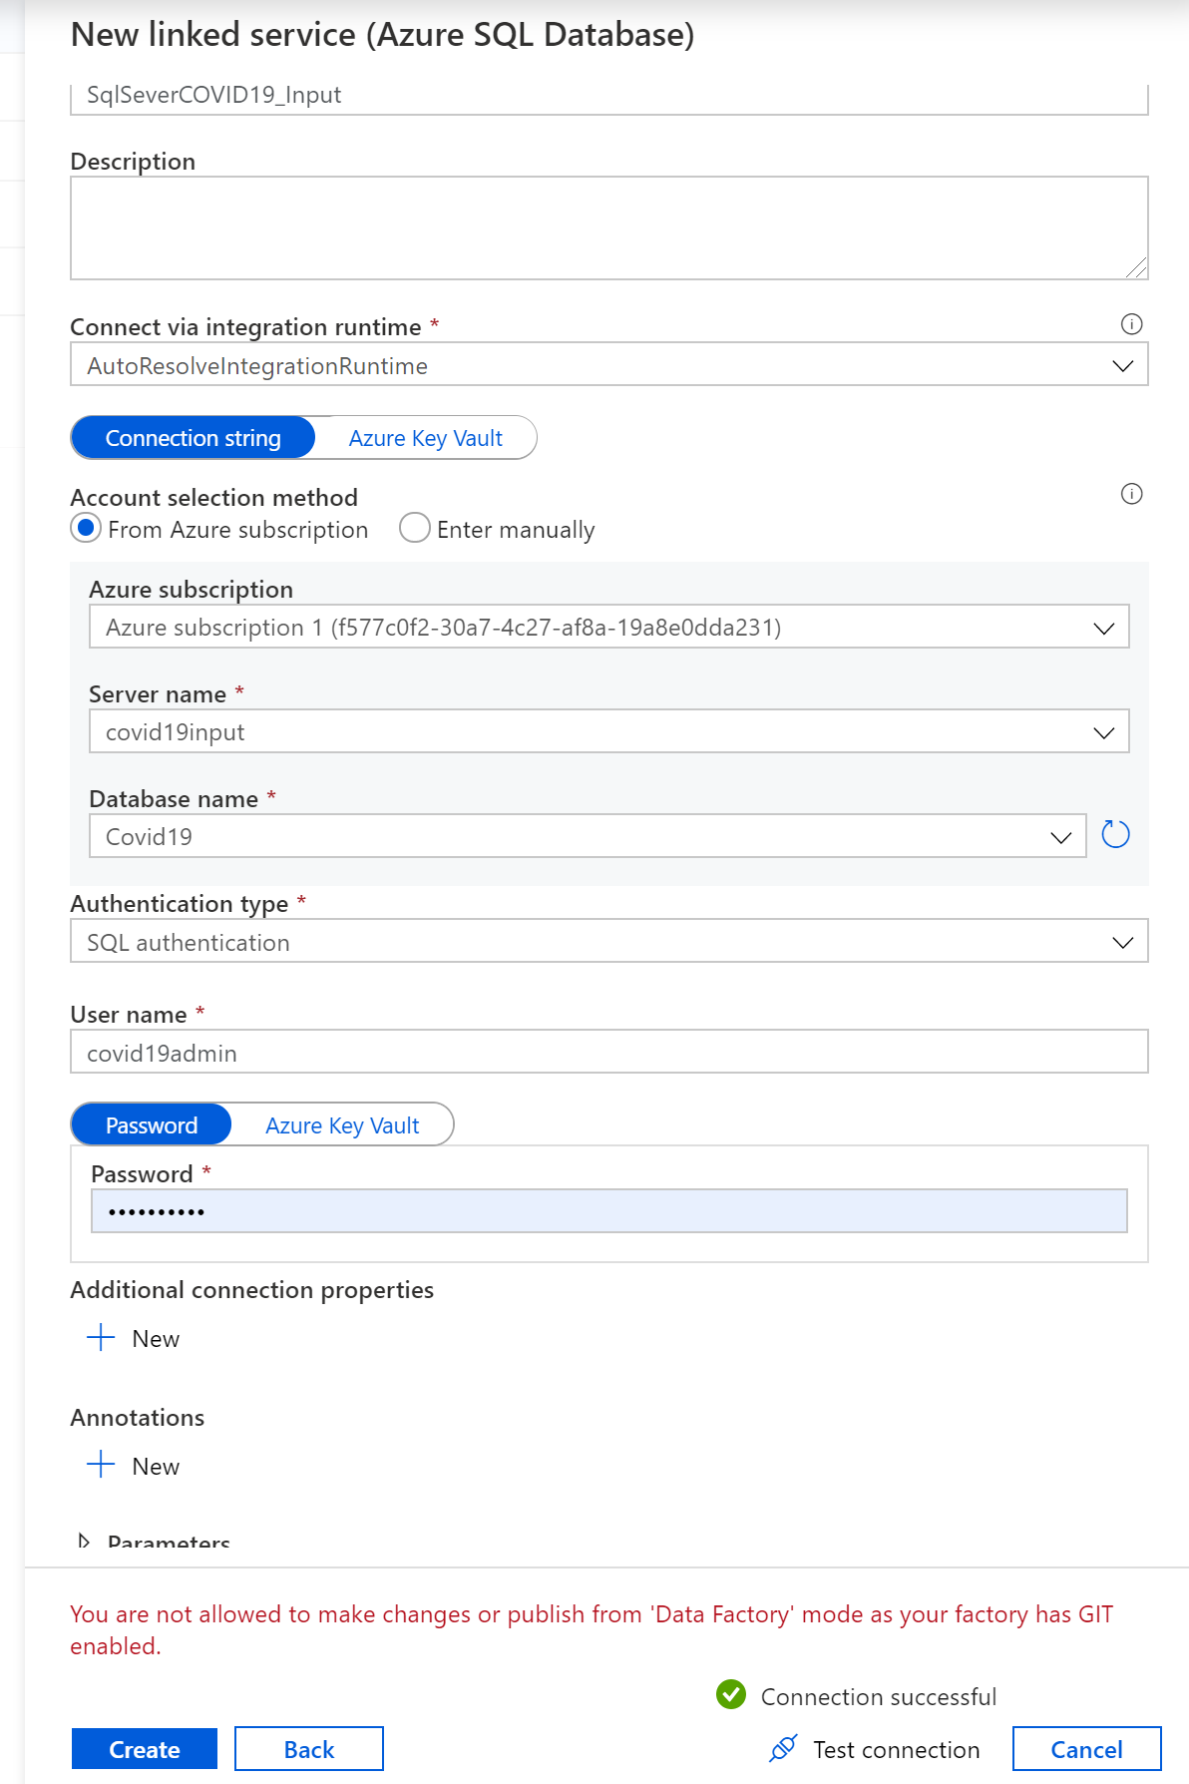
Azure Data Factory– Test SQL Server Connection

Slide 31
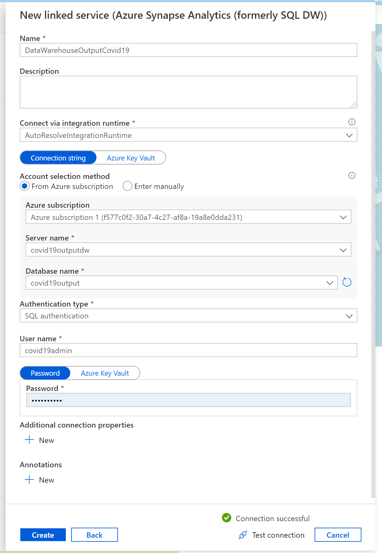
Azure Data Factory– Test SQL Server Connection

Slide 32
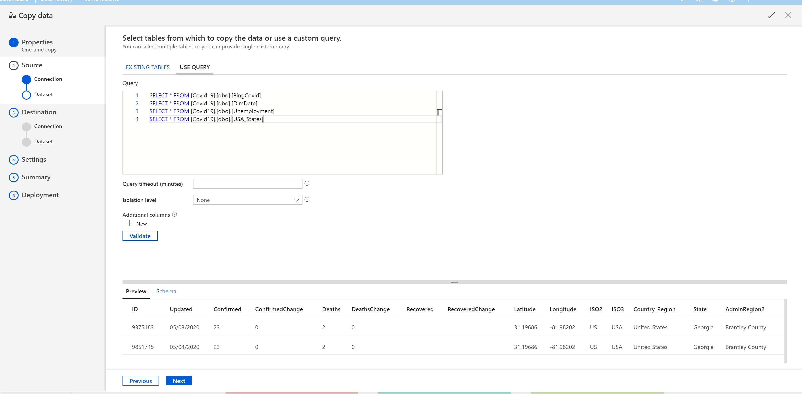
Azure Data Factory– copy data – remember to valitate

Slide 33
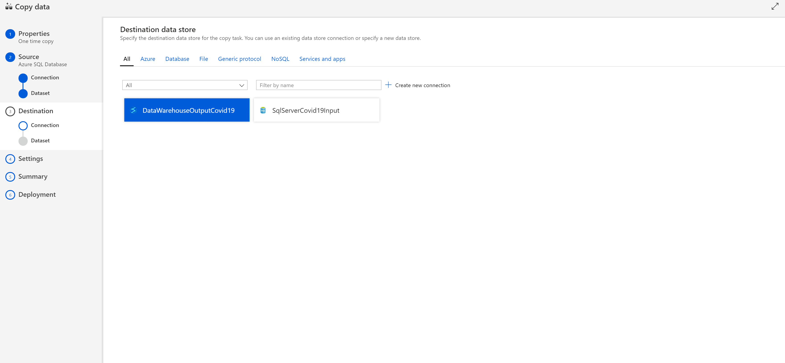
Azure Data Factory– Copy data destination

Slide 34
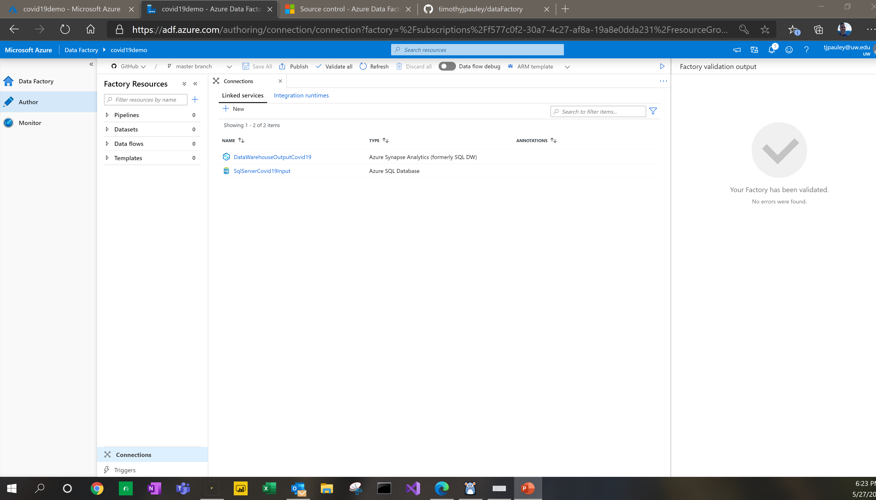
Azure Data Factory– Github Repo setup and publish

Slide 35
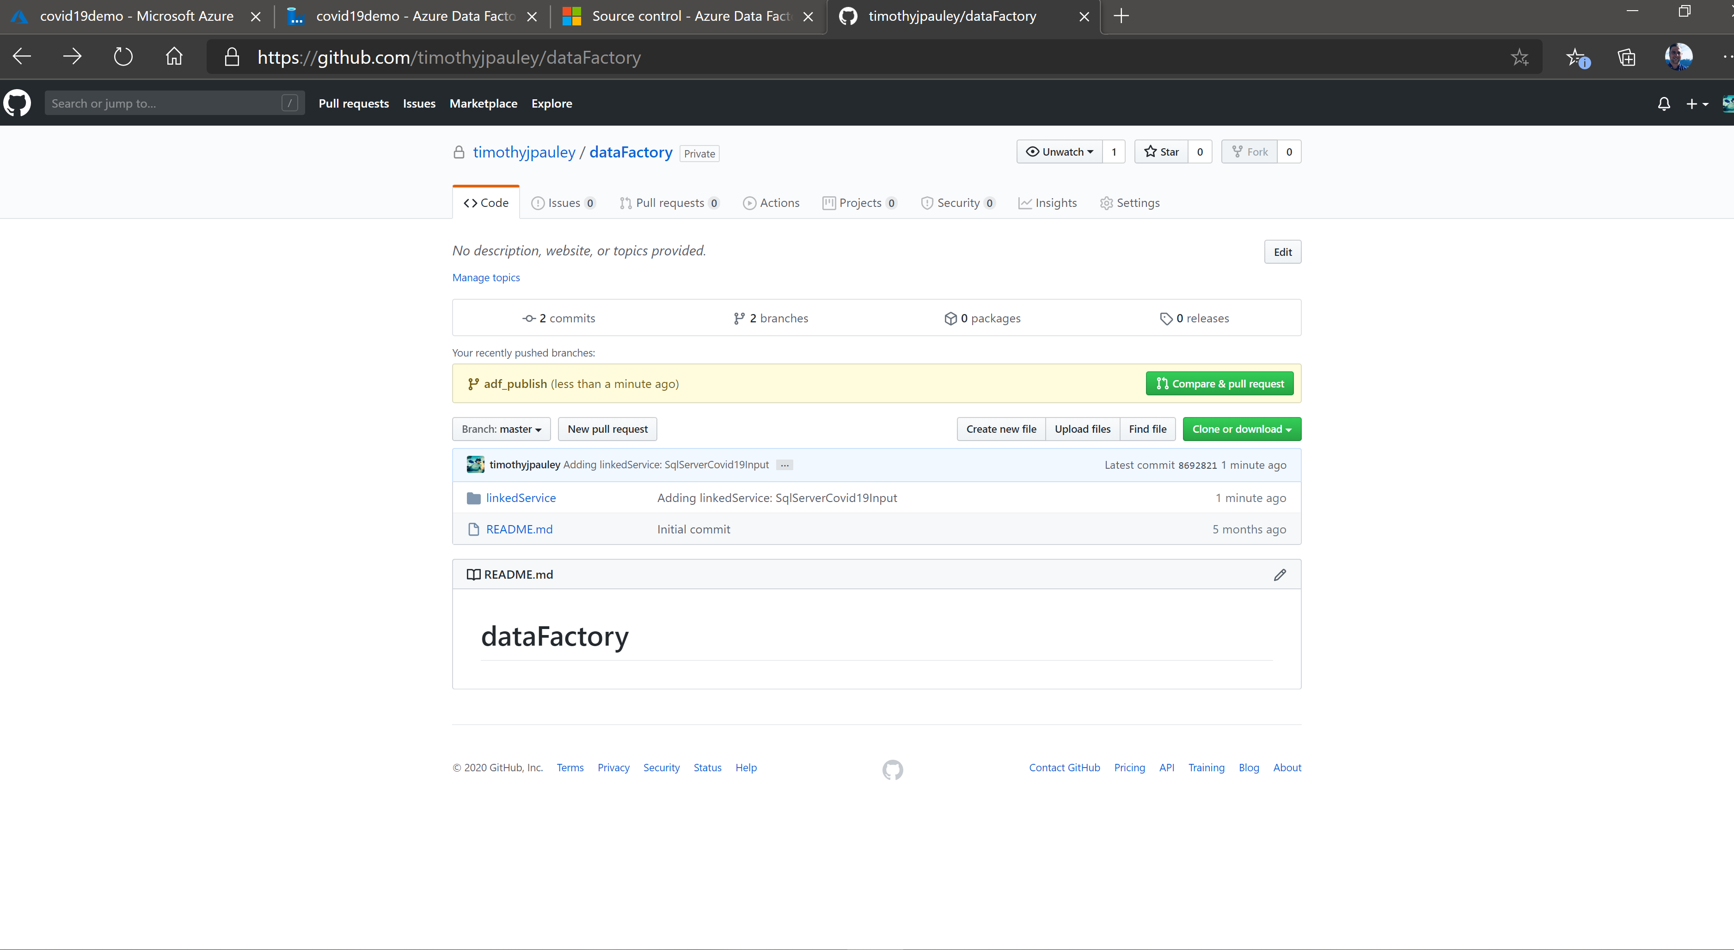
Azure Data Factory– Github Repo setup and publish

Slide 36
Azure Data Factory
Create A blob storage account
https://docs.microsoft.com/en-us/azure/data-factory/quickstart-create-data-factory-copy-data-tool

